Slide 1
Data Structures and Algorithms Lecture 7: Quick Sort
Department of Computer Science & Technology
United International College

Slide 2
Outline
Introduction to Quick Sort
Quick Sort Components
Partitioning
Small Array Strategy
Picking the Pivot
Cost Analysis

Slide 3
Introduction
Fastest sorting algorithm in practice
A lot of variations exist
Not Stable
Average case cost: O(N log N)
Worst case cost: O(N²)
But, the worst case seldom happens.
Another divide-and-conquer algorithm

Slide 4
● Divide ● Conquer ● Combine
Quick sort, another divide-and-conquer algorithm

Slide 5
Divide
Pick an element v in S
v is called the pivot
Many ways to pick a pivot
Partition S–{v} into two disjoint groups
S1 = {x ∈ S – {v} | x <= v}
S2 = {x ∈ S – {v} | x >= v}
Recursively divide S1 and S2
S
v
v
S1
S2

Slide 6
Conquer
If there is no more than 1 element in S, return directly.
Combine
No action is needed.
The sorted S1 (when the recursion is done) followed by v, followed by the sorted S2 (when the recursion is done), make a sorted new list.

Slide 7
Example
Pick a pivot | 2 | 6 | 1 | 4 | 9 | 5 | 3 | 0 | 7 | 8
Partition | 2 | 3 | 1 | 0 | 4 | 5 | 6 | 9 | 7 | 8
Pick a pivot | 2 | 3 | 1 | 0 | 4 | 5 | 6 | 9 | 7 | 8
Partition | 0 | 1 | 3 | 2 | 4 | 5 | 6 | 9 | 7 | 8
Pick a pivot | 0 | 1 | 3 | 2 | 4 | 5 | 6 | 9 | 7 | 8
Conquer
Partition | 0 | 1 | 2 | 3 | 4 | 5 | 6 | 9 | 7 | 8
The right half can be solved similarly
Conquer

Slide 8
“Divide” is the key
Nothing is done in conquer and combine

Slide 9
Animation
Animation
Note that
There are various methods to choose a pivot
There are various methods to partition a sub-array

Slide 10
Pseudo Code
QUICKSORT(A, left, right) 1. IF left >= right 2. return 3. q = PARTITION(A, left, right) 4. //q is the position of the pivot 5. QUICKSORT(A, left, q-1) 6. QUICKSORT(A, q+1, right)

Slide 11
Partitioning
Partitioning
This is a key step of the quicksort algorithm
Goal: given the picked pivot, partition the remaining elements into two smaller sets
Many ways to implement how to partition
Even the slightest deviations may cause surprisingly bad results.
We will learn an easy and efficient partitioning strategy here.
How to pick a pivot will be discussed later

Slide 12
Partitioning Strategy
Want to partition an array A[left .. right]
Get the pivot element out of the way by swapping it with the last element. (Swap pivot and A[right])
Let i start at the first element and j start at the next-to-last element
i = left, j = right – 1
Pick a pivot | 2 | 6 | 1 | 4 | 9 | 5 | 3 | 0 | 7 | 8
Swap | 2 | 6 | 1 | 8 | 9 | 5 | 3 | 0 | 7 | 4
i
j

Slide 13
Partitioning Strategy
Goal:
A[left..i] are smaller or equal to the pivot
A[j..right] are greater or equal to the pivot
Strategy:
When i < j
Move i right, skipping over elements smaller than the pivot
Move j left, skipping over elements greater than the pivot
When both i and j have stopped
A[i] >= pivot
A[j] <= pivot { A[i] and A[j] should now be swapped}
Scan | 2 | 6 | 1 | 8 | 9 | 5 | 3 | 0 | 7 | 4
i
i
j
j

Slide 14
Partitioning Strategy
When i and j have stopped and i is to the left of j (thus legal)
Swap A[i] and A[j]
And then both elements are on the “correct” side
After swapping
A[i] <= pivot
A[j] >= pivot
Repeat the process until i and j cross
Swap | 2 | 0 | 1 | 8 | 9 | 5 | 3 | 6 | 7 | 4
i
j

Slide 15
Scan | 2 | 0 | 1 | 8 | 9 | 5 | 3 | 6 | 7 | 4
i
j
Swap | 2 | 0 | 1 | 3 | 9 | 5 | 8 | 6 | 7 | 4
i
j
Scan | 2 | 0 | 1 | 3 | 9 | 5 | 8 | 6 | 7 | 4
j
i
i and j cross now!

Slide 16
Partitioning Strategy
When i and j have crossed
Swap A[i] and pivot
Result:
A[p] <= pivot, for p < i
A[p] >= pivot, for p > I
Partition complete
Scan | 2 | 0 | 1 | 3 | 4 | 5 | 8 | 6 | 7 | 9
j
i

Slide 17
Pseudo Code
PARTITION(A, left, right) 1. p = PIVOT(A, left, right) 2. //p is the position of the pivot 3. swap A[p] and A[right] 4. i = left, j = right-1, pivot = A[right] 5. WHILE true 6. WHILE i<right AND A[i]<pivot
7. i++
8. WHILE j>=left AND A[j]>pivot
9. j--
10. IF i<j
11. swap A[i] and A[j]
12. i++, j--
13. ELSE
14. BREAK
15. swap A[i] and A[right]

Slide 18
Small arrays
For very small arrays, quicksort does not perform as well as insertion sort
how small depends on many factors, such as the time spent making a recursive call, the compiler, etc
Do not use quicksort recursively for small arrays
Instead, use a sorting algorithm that is efficient for small arrays, such as insertion sort

Slide 19
Quick Sort + Small Array Strategy
QUICKSORT(A, left, right) 1. IF left >= right - 10 2. INSERTIONSORT(A, left, right)
3. RETURN 4. q = PARTITION(A, left, right) 5. //q is the position of the pivot 6. QUICKSORT(A, left, q-1) 7. QUICKSORT(A, q+1, right)

Slide 20
Picking the PIVOT

Slide 21
Strategy I
Use the first element as pivot
if the input is random, ok
if the input is presorted (or in reverse order)
all the elements go into S2 (or S1)
this happens consistently throughout the recursive calls
Results in O(n²) behavior

Slide 22
Strategy II
Choose the pivot randomly
generally safe
random number generation can be expensive

Slide 23
Strategy III
Use the median of the array
The median is the middle element if the array is sorted. For example, if there are 9 elements in the array, the median is the 5th largest one.
Partitioning always cuts the array into roughly half
An optimal quicksort: O(N log N)
However, expensive to find the exact median
e.g., sort an array to pick the value in the middle

Slide 24
Strategy IV
We will use median of three
Compare just three elements: the left most, right most and center
Swap these elements if necessary so that
A[left] = Smallest
A[right] = Largest
A[center] = Median of three
Pick A[center] as the pivot
Swap A[center] and A[right – 1] so that pivot is at second last position
WHY?

Slide 25
Median3 Example
median3 | 2 | 6 | 1 | 4 | 9 | 5 | 3 | 0 | 8 | 7
reposition | 2 | 6 | 1 | 4 | 7 | 5 | 3 | 0 | 8 | 9
pick pivot | 2 | 6 | 1 | 4 | 7 | 5 | 3 | 0 | 8 | 9
swap | 2 | 6 | 1 | 4 | 8 | 5 | 3 | 0 | 7 | 9
i
j

Slide 26
Partition With Median3
PARTITION(A, left, right) 1. MEDIAN3(A, left, right) 2. // MEDIAN3 repositions the left, center
3. // and the right elements 4. i = left+1, j = right-2, pivot = A[right-1] 5. WHILE true 6. WHILE A[i]<pivot
7. i++
8. WHILE A[j]>pivot
9. j--
10. IF i<j
swap A[i] and A[j]
i++, j--
13. ELSE
14. BREAK
15. Swap A[i] and A[right-1]
No boundary check. Why?

Slide 27
Quicksort Faster than Mergesort
Both quicksort and mergesort take O(N log N) in the average case.
Why is quicksort faster than mergesort?
The inner loop consists of an increment/decrement (by 1, which is fast), a test and a jump.
There is no extra juggling as in mergesort.

Slide 28
Analysis
Assumptions
Pivot Selection: Median of 3
Base Case: Array size <= 10
Running time T(n)
Divide
Pivot selection: O(1)
Partitioning: O(n)
Recursive calls: T(i) + T(n-i-1)
i: number of elements in S1
Conquer and Combine: O(1)
T(n)=T(i)+T(n-i-1)+O(n)

Slide 29
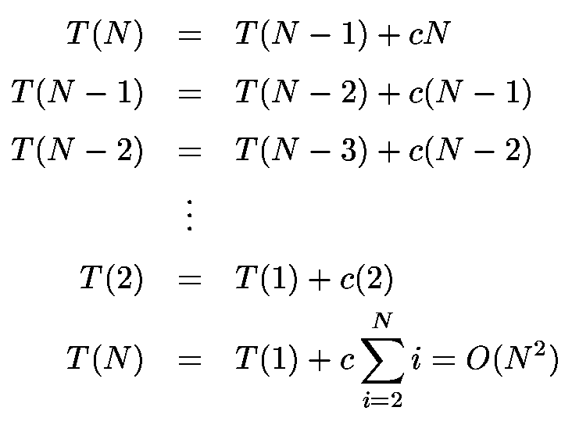
Worst-Case Analysis
What will be the worst case?
The pivot is the smallest element, all the time
Partition is always unbalanced

Slide 30
Best-case Analysis
What will be the best case?
Partition is perfectly balanced
Pivot is always in the middle (median of the array)
T(n) = 2T(n/2) + n
= 2[2T(n/2²) + n/2] + n
= 2²T(n/2²) + 2n
= 2³T(n/2³) + 3n
= 2^{i}T(n/2^{i}) + i*n
Let i=log(n),
= nT(n/n) + n*log(n)
= O(n*log(n))

Slide 31
Average-Case Analysis
Assume
Each of the sizes for S1 is equally likely
This assumption is valid for our pivoting (median-of-three) strategy
On average, the running time is O(N log N)
Covered in
DESIGN AND ANALYSIS OF ALGORITHMS

Slide 32
Consider special cases
When all elements are the same?
Other cases?

Slide 33

Analysis of Quick Sort
Best-case Running Time | O(nlog(n))
Worst-case Running Time | O(n²)
Average Running Time | O(nlog(n))
Quick sort is not stable
But it is the fastest in practice
The worst case seldom happens

Slide 34
Task
Create a class, Sorting3, which includes at least the following static methods
public static void insertionSort(int[] A)
public static void mergeSort(int[] A)
Two overloading quickSort methods
public static void quickSort(int[] A)
private static void quickSort(int[] A, int left, int right)
public static void main(String[] args)
Auxiliary methods may be defined
Submit Sorting3.java to iSpace

Slide 35
Task
public static void quickSort(int[] A)
It calls the recursive quickSort method to sort A
quickSort(A, 0, A.length-1)
private static void quickSort(int[] A, int left, int right)
Sort sub-array A[left..right] recursively using quick sort
Pivot is picked using median-of-3
Switch to insertionSort for small arrays
Test on your computer and find the best BASE CASE for you
When shall we switch to insertionSort?
Overload the existing insertionSort so that it can sort a sub-array
private static void insertionSort(int[] A, int left, int right)

Slide 36
Task
public static void main(String[] args)
Generate an array A1 consisting of 10⁵ random integers which are in range [0, 999]
Generate arrays A2, A3 which are identical to A1
Sort A1 using insertionSort, A2 using mergeSort, and A3 using quickSort
Print the elapsed time in milliseconds during which all the search functions run, respectively
You can use the sample code on iSpace for existing methods

